Slide 1
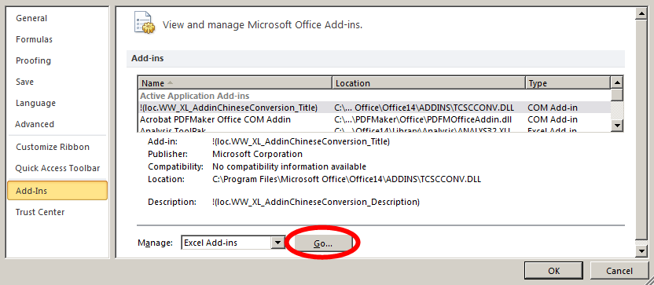
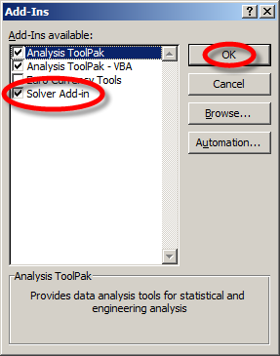
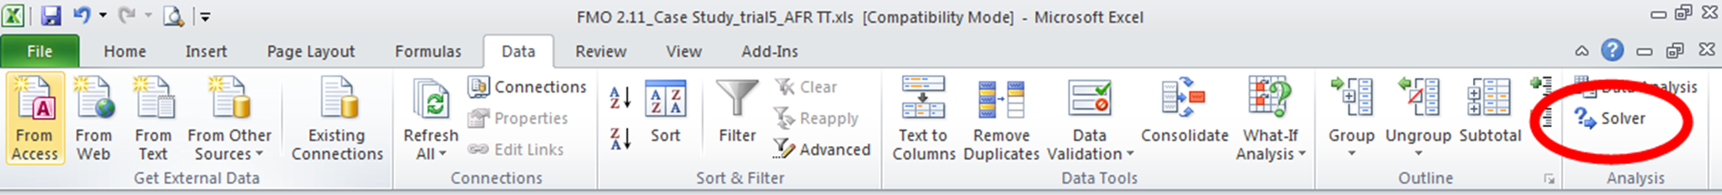
How to enable Solver in Excel
In Excel File Tab → select Options
Click on Add-Ins → Manage: Excel Add-Ins → click Go…
The window below opens
→ tick Solver Add-in → click OK
When you were successful you should see under Excel Data Tab on the right side the Solver functionality as shown below:

